Slide 1
Lab 4
By Victoria Li
January 31, 2014

Slide 2
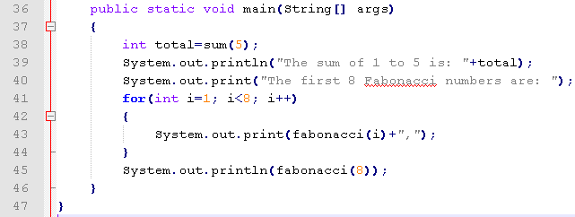
When run “java Lab5”, main is called.
Then line 38 is executed -> sum(5) is called.
The program waits for the result of sum(5)
The current content is saved on system stack

Slide 3
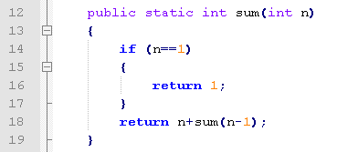
Control switched to sum(5)
Line 12 is executed. “int” 5 is copied to local variable n, line 14 “if (n==1)” is not true, line 18 is executed, it waits at “return 5+sum(4)”
The current content is saved on system stack

Slide 4
Control switched to sum(4)
Line 12 is executed. “int” 4 is copied to local variable n, line 14 “if (n==1)” is not true, line 18 is executed, it waits at “return 4+sum(3)”
The current content is saved on system stack

Slide 5
Control switched to sum(3)
Line 12 is executed. “int” 3 is copied to local variable n, line 14 “if (n==1)” is not true, line 18 is executed, it halts at “return 3+sum(2)”
The current content is saved on system stack

Slide 6
Control switched to sum(2)
Line 12 is executed. “int” 2 is copied to local variable n, line 14 “if (n==1)” is not true, line 18 is executed, it halts at “return 2+sum(1)”
The current content is saved on system stack

Slide 7
Control switched to sum(1)
Line 12 is executed. “int” 1 is copied to local variable n, line 14 “if (n==1)” is true, line 16 is executed, it returns 1.

Slide 8
Visualizing System Stack
When control is switched because sum(x) is called, the current content is saved on system stack.
In sum(2), waits for sum(1)
top of the stack
In sum(3), waits for sum(2)
In sum(4), waits for sum(3)
In sum(5), waits for sum(4)
In main, waits for sum(5)

Slide 9
When sum(1) is returned, Control is switched back to Line 18 of sum(2) by popping it from the system stack
return 2+1;
In sum(3), waits for sum(2)
top of the stack
In sum(4), waits for sum(3)
In sum(5), waits for sum(4)
In main, waits for sum(5)

Slide 10
When sum(2) is returned, Control is switched back to Line 18 of sum(3) by popping it from the system stack
return 3+3;
In sum(4), waits for sum(3)
top of the stack
In sum(5), waits for sum(4)
In main, waits for sum(5)

Slide 11
When sum(3) is returned, Control is switched back to Line 18 of sum(4) by popping it from the system stack
return 4+6;
In sum(5), waits for sum(4)
top of the stack
In main, waits for sum(5)

Slide 12
When sum(4) is returned, Control is switched back to Line 18 of sum(5) by popping it from the system stack
return 5+10;
In main, waits for sum(5)
top of the stack

Slide 13
When sum(5) is returned, Control is switched back to line 38 of main by popping it from the system stack
In main, line 38, total=15;
top of the stack

